Slide 2
First Minimum
Circular Aperture
θ
D
w
Central Maximum
Intensity Pattern
L

Slide 6
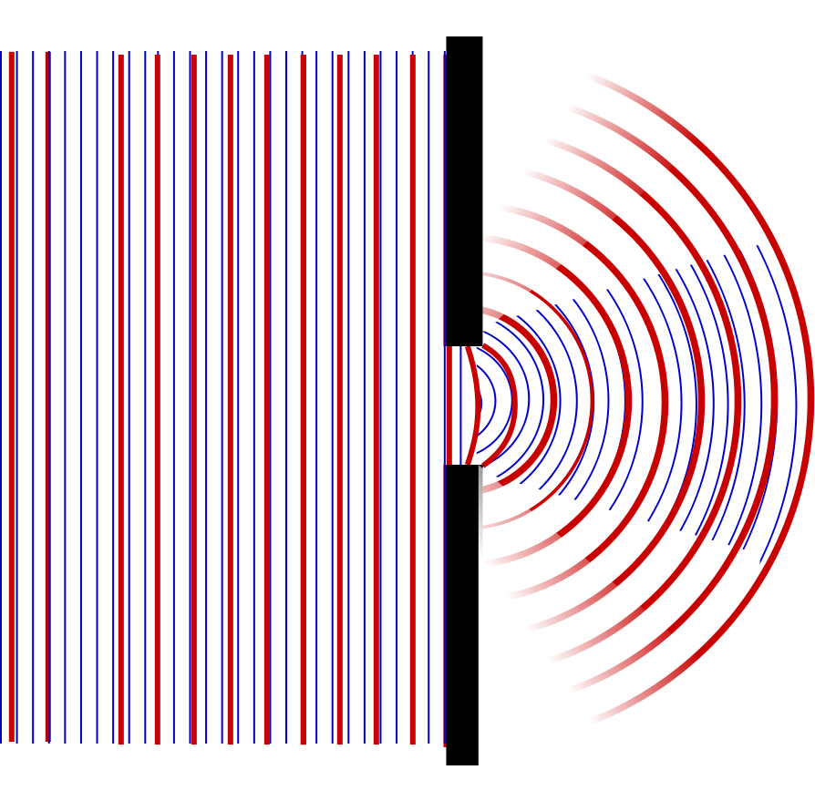

Slide 7
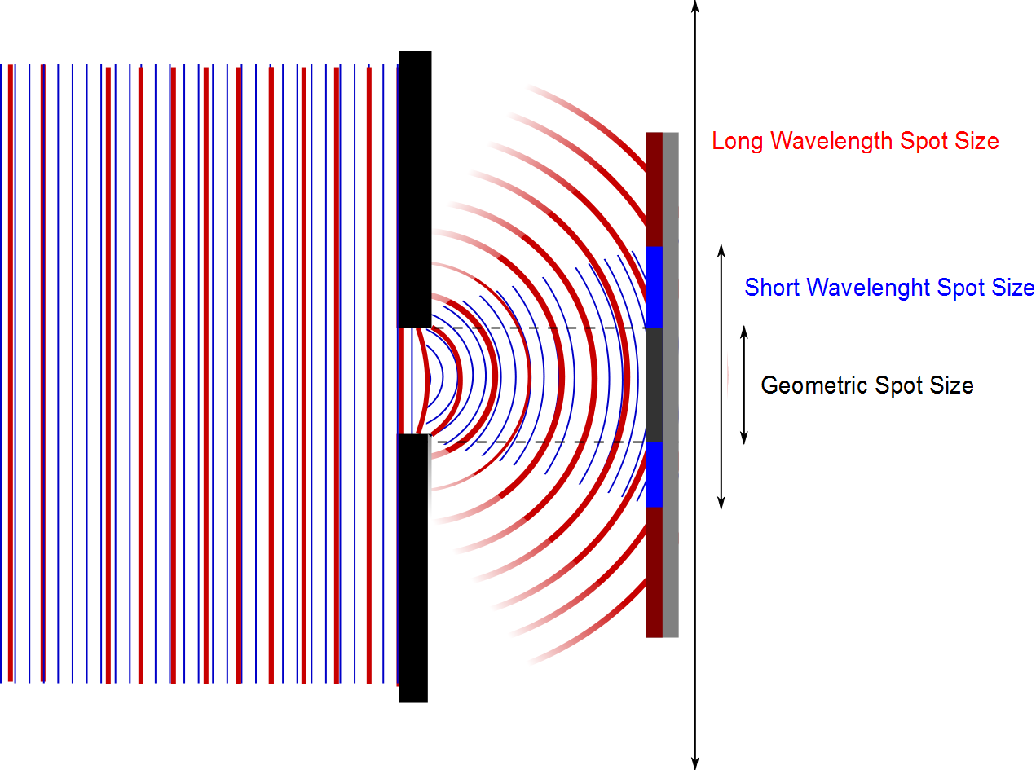

Slide 8
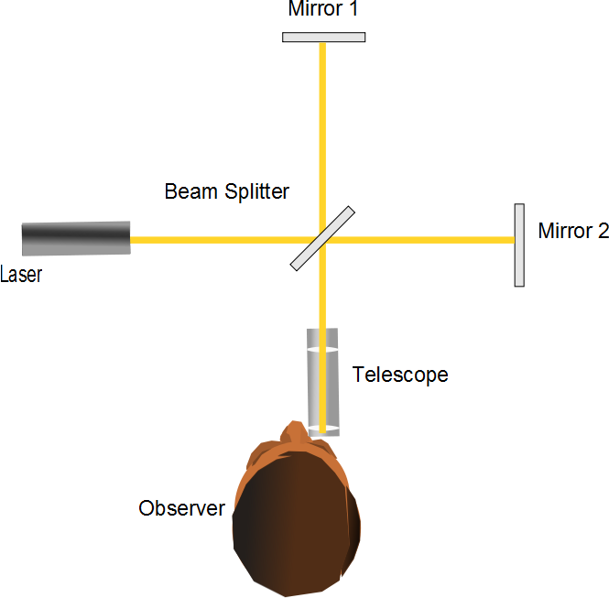
L₁
L₂

Slide 9
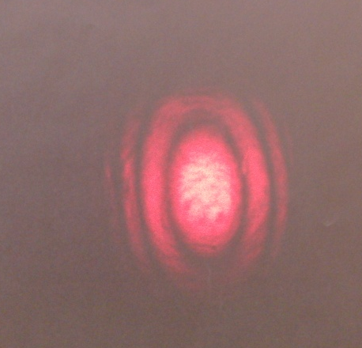
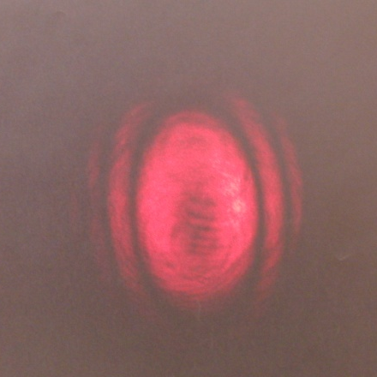
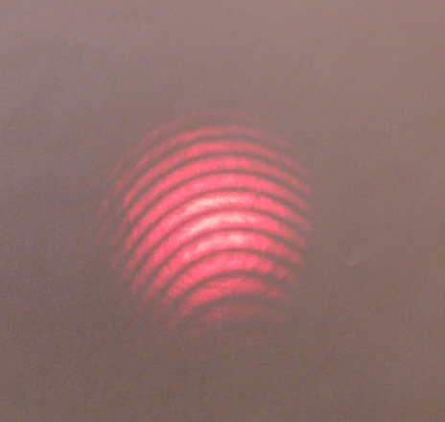
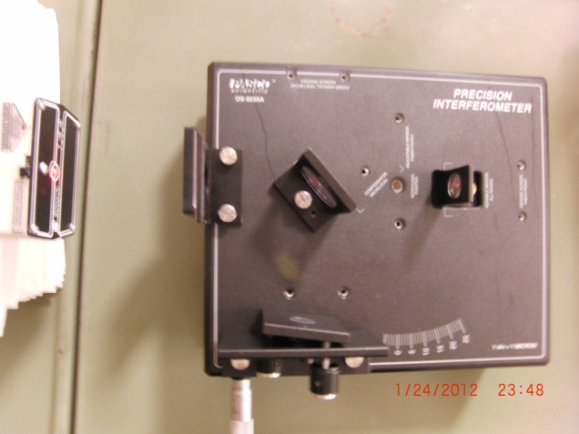
Bright Center
Dark Center
Small Off-Center Fringes
To Screen
Laser
Movable Mirror
Beam Splitter
Fixed Mirror

Slide 10
Holography
Beam Splitter
Mirror)
Light from laser expanded with beam expander
Interference Pattern
(Hologram)
Object

Slide 11
Holography Reconstruction
Mirror)
Light from laser expanded with beam expander
Interference Pattern
(Hologram)
Reconstructed Image of Object

Slide 12
Diffraction of X-Rays by Crystals
X-rays are electromagnetic waves of very short wavelength
Max von Laue suggested that the regular array of atoms in a crystal could act as a three-dimensional diffraction grating for x-rays

Slide 13
Incident Beam
Reflected Beam
θ
θ
First Row of Atoms
d
θ
Second Row of Atoms

Slide 14
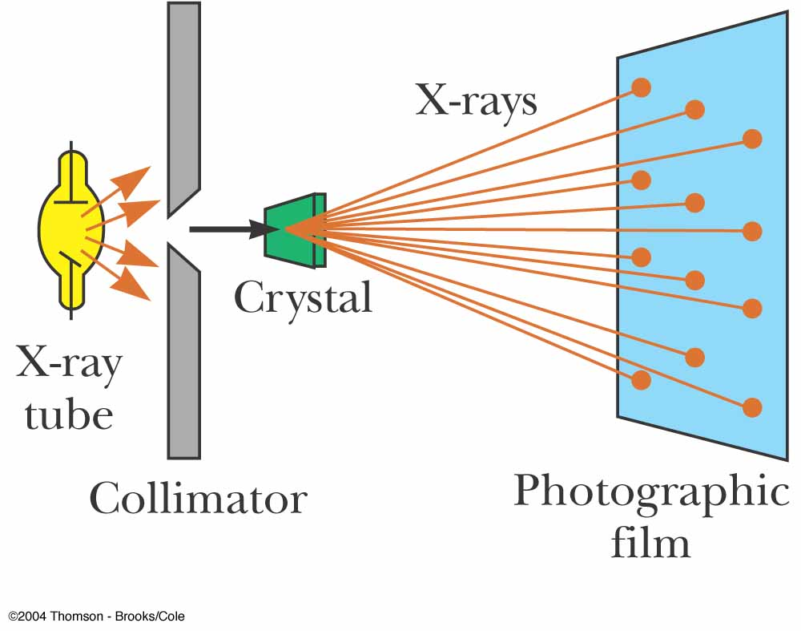
Diffraction of X-Rays by Crystals, Set-Up
A collimated beam of monochromatic x-rays is incident on a crystal
The diffracted beams are very intense in certain directions
This corresponds to constructive interference from waves reflected from layers of atoms in the crystal
The diffracted beams form an array of spots known as a Laue pattern

Slide 15
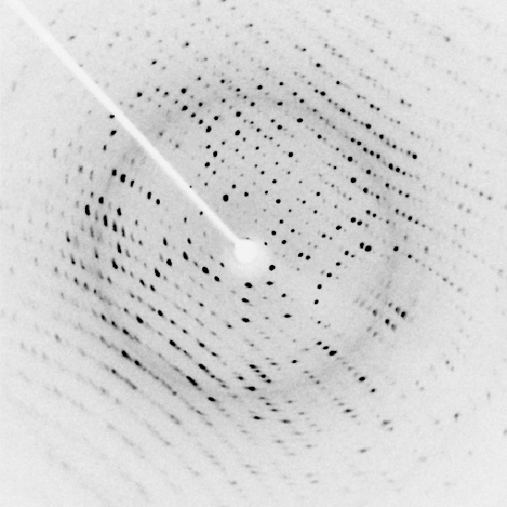

Slide 16
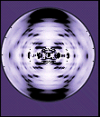

Slide 17
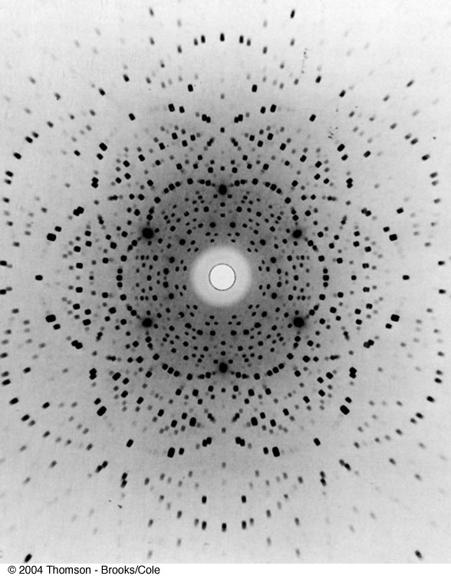
Laue Pattern for Beryl

Slide 18
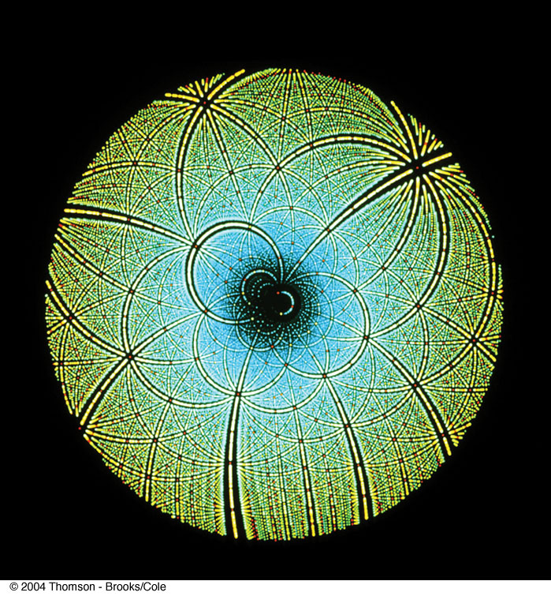
Laue Pattern for Rubisco

